Slide 1
Predicting NYPD Response Times after Dispatch
Max Grove | mg6392@nyu.edu
Big Data | Dr. Juan Rodriguez
Tandon School of Engineering
New York University

Slide 2
Outline
Introduction
Data
Pipeline of application
Loading Data
Sampling Data
Cleaning Data
Exploring Data
Modeling
Conclusion

Slide 3

Introduction
Goal
Two datasets:
Historic
2.3 GB size
20 columns
40.7M Rows
YTD
~900 MB size
18 columns
3.6M rows
Predict how long it takes a dispatched NYPD officer to arrive at the scene
DataSet
NYC’s Open Data Initiative
Documented information on NYPD 911 calls and responses
Data is operated by members of the public and NYPD members
Operated by members of the public and NYPD professionals
Introduction
Data
Pipeline
Loading Data
Sampling Data
Cleaning Data
Evaluating Data
Model
Conclusion
Notes:
Data columns can change. We could add or subtract columns as the NYPD or public deems necessary
It is managed by two different entities – this could lead to differences in how data is handled and will require preprocessing
Handled by two extremely large datasets
Has long-text columns that can only be handled with big data tools

Slide 4
Data Definition
Identifiers
Timestamps
Location
objectid | Number
cad_evnt_id | Number
create_date | Floating Timestamp
incident_date | Floating Timestamp
incident_time | Text
add_ts | Floating Timestamp
disp_ts | Floating Timestamp
arrivd_ts | Floating Timestamp
closng_ts | Floating Timestamp
boro_nm | Text
patrl_boro_nm | Text
geo_cd_x | Number
geo_cd_y | Number
latitude | Number
longitude | Number
location | Point
Miscellaneous
nypd_pct_cd | Number
radio_code | Text
typ_desc | Text
cip_jobs | Text
Introduction
Data
Pipeline
Loading Data
Sampling Data
Cleaning Data
Evaluating Data
Model
Conclusion

Slide 5



Pipelining Data and Technology
Cleaning data
Exploring data
Modeling data
Collecting and understanding Data
Hosting data and indexing
Introduction
Data
Pipeline
Loading Data
Sampling Data
Cleaning Data
Evaluating Data
Model
Conclusion
Notes:
Three main aspects of this study. Input/Output, CPUs, and how these drive wait times. They all interconnect and input/output is an inevitable part of any CPU process, especially in today’s world as data grows larger and larger.
I’ll explore the operational considerations of custom CPU Scheduling algorithms in high I/O settings.
There is currently limited research on this specific aspect
I’ll also share where processes experience long I/O waits, such as those found in an airline kiosk setting.

Slide 6
Loading Data to MongoDB
api_endpoint_ytd = "https://data.cityofnewyork.us/resource/n2zq-pubd.json"
api_endpoint_historic = "https://data.cityofnewyork.us/resource/d6zx-ckhd.json"
Create an App Token with NYC Open Data
Fetch the data from the APIs - 20,000 data points per call
Insert into a Mongo DB collection
Key MongoDB Features Used
Add indexes on INCIDENT_DATE and cad_evnt_id
Add in INCIDENT_YEAR and INCIDENT_DATE fields to sample by year-month
Add indexes on INCIDENT_YEAR and INCIDENT_DATE
Introduction
Data
Pipeline
Loading Data
Sampling Data
Cleaning Data
Evaluating Data
Model
Conclusion
Notes:
Three main aspects of this study. Input/Output, CPUs, and how these drive wait times. They all interconnect and input/output is an inevitable part of any CPU process, especially in today’s world as data grows larger and larger.
I’ll explore the operational considerations of custom CPU Scheduling algorithms in high I/O settings.
There is currently limited research on this specific aspect
I’ll also share where processes experience long I/O waits, such as those found in an airline kiosk setting.

Slide 7
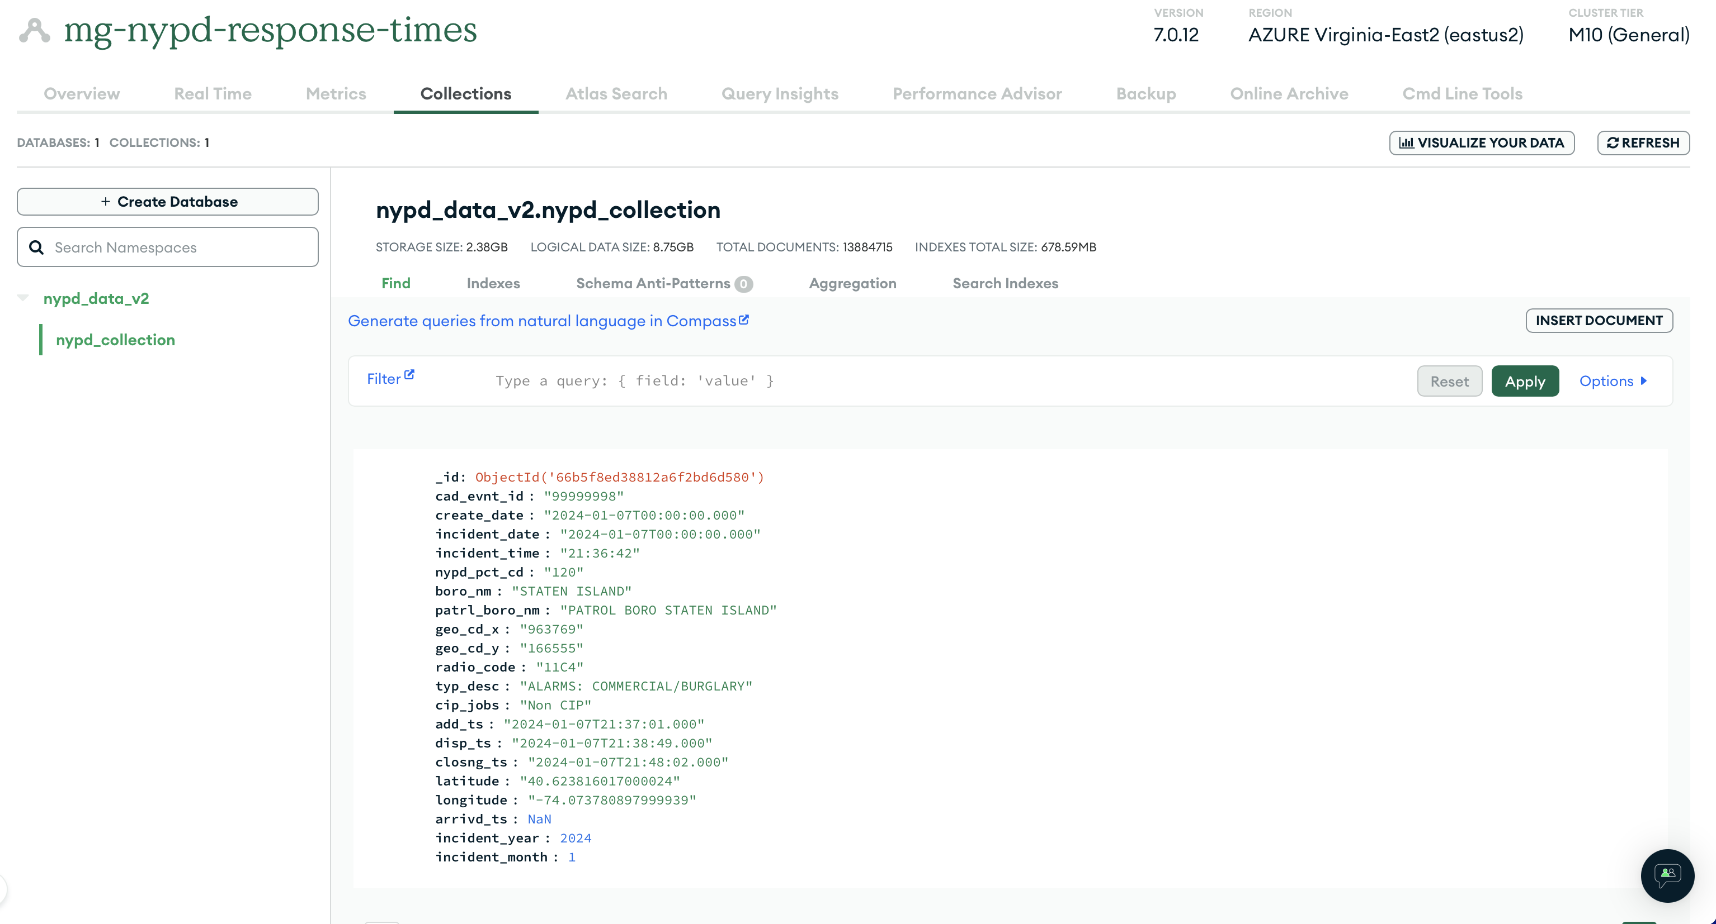
Sampling Data from MongoDB
Key Benefits
Save on space
Ensure we get data from all time periods
Utilize indexed rows
Don’t have to rely on API and data is backed up
Pull all available month-year combinations from MongoDB
Pull 1,000 rows from each month-year down into the local JupyterHub environment
Introduction
Data
Pipeline
Loading Data
Sampling Data
Cleaning Data
Evaluating Data
Model
Conclusion

Slide 8
Cleaning and Preparing Data
Initial Schema
22 columns and 22,000 rows
Cleaned Schema
22 columns and 5,291 rows
_Id
Cad_evnt_id
Create_date
Incident_date
Incident_time
Nypd_pct_cd
Boro_nm
Patrl_boro_nm
Geo_cd_x
Geo_cd_y
Radio_code
Typ_desc
Cip_jobs
Add_ts
Disp_ts
Closng_ts
Latitude
Longitude
Location
Incident_year
Incident_month
Arrivd_ts
Cleaning
Dropping unnecessary columns
Dropping missing values
Cleaning dates
New Features
Tokenize words and create feature flags
New time features
Linking data to NYC Neighborhood data
Key data: Time to arrive from dispatch time
NYPD_PCT_CD
BORO_NM
RADIO_CODE
CIP_JOBS
INCIDENT_YEAR
INCIDENT_MONTH
TYP_DESC_HAS_{SELECTED_WORDS}
HOUR
WEEKDAY
TIME_TO_ARRIVE_FROM_DISPATCH
NEIGHBORHOOD
* New Features
Introduction
Data
Pipeline
Loading Data
Sampling Data
Cleaning Data
Evaluating Data
Model
Conclusion
Notes:
Coalescing dates: incident date and time, then coalesce with ADD_TS

Slide 9
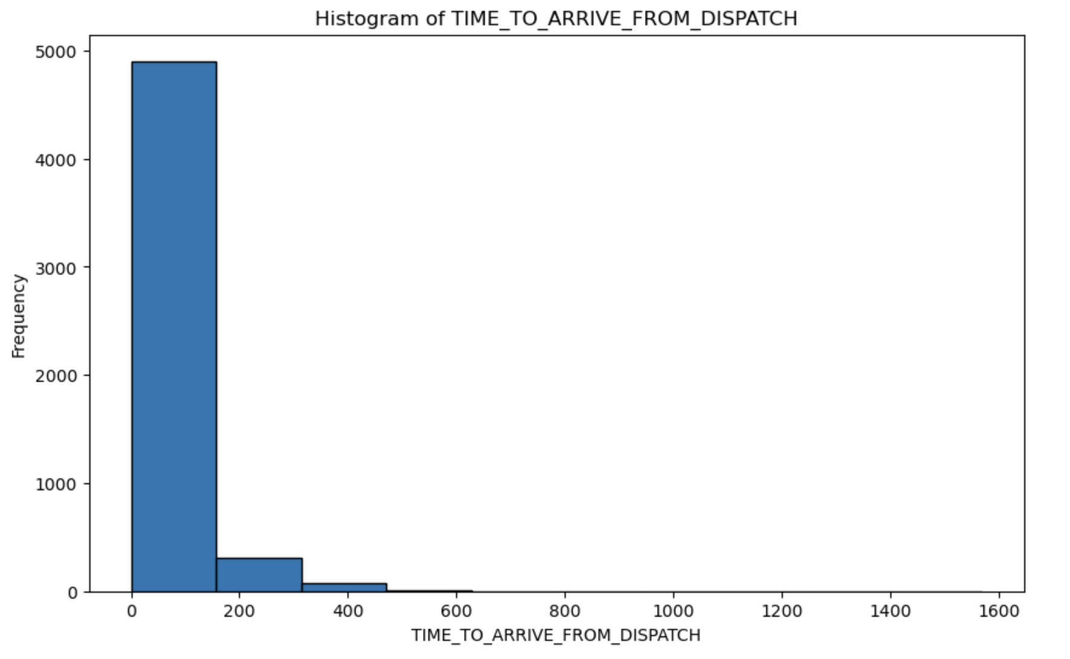
Evaluating and Understanding Data
Introduction
Data
Pipeline
Loading Data
Sampling Data
Cleaning Data
Evaluating Data
Model
Conclusion

Slide 10
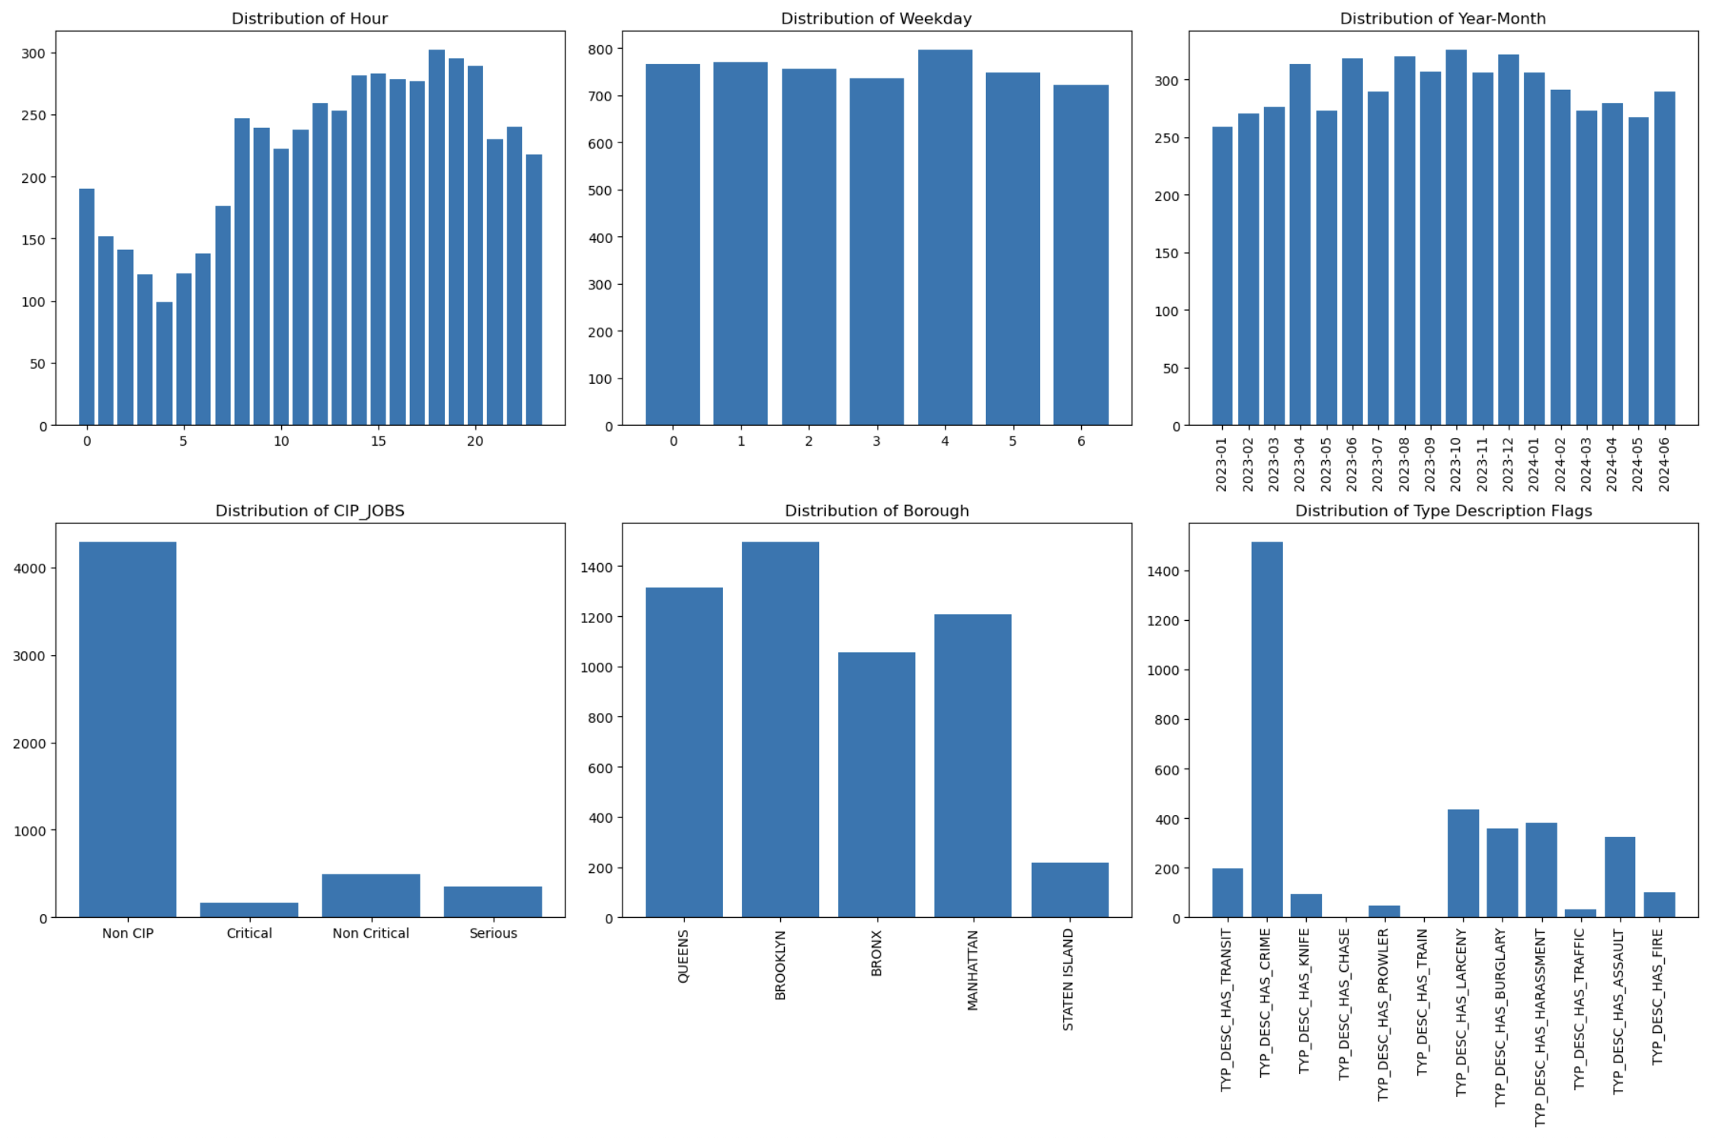
Evaluating and Understanding Data
Introduction
Data
Pipeline
Loading Data
Sampling Data
Cleaning Data
Evaluating Data
Model
Conclusion

Slide 11
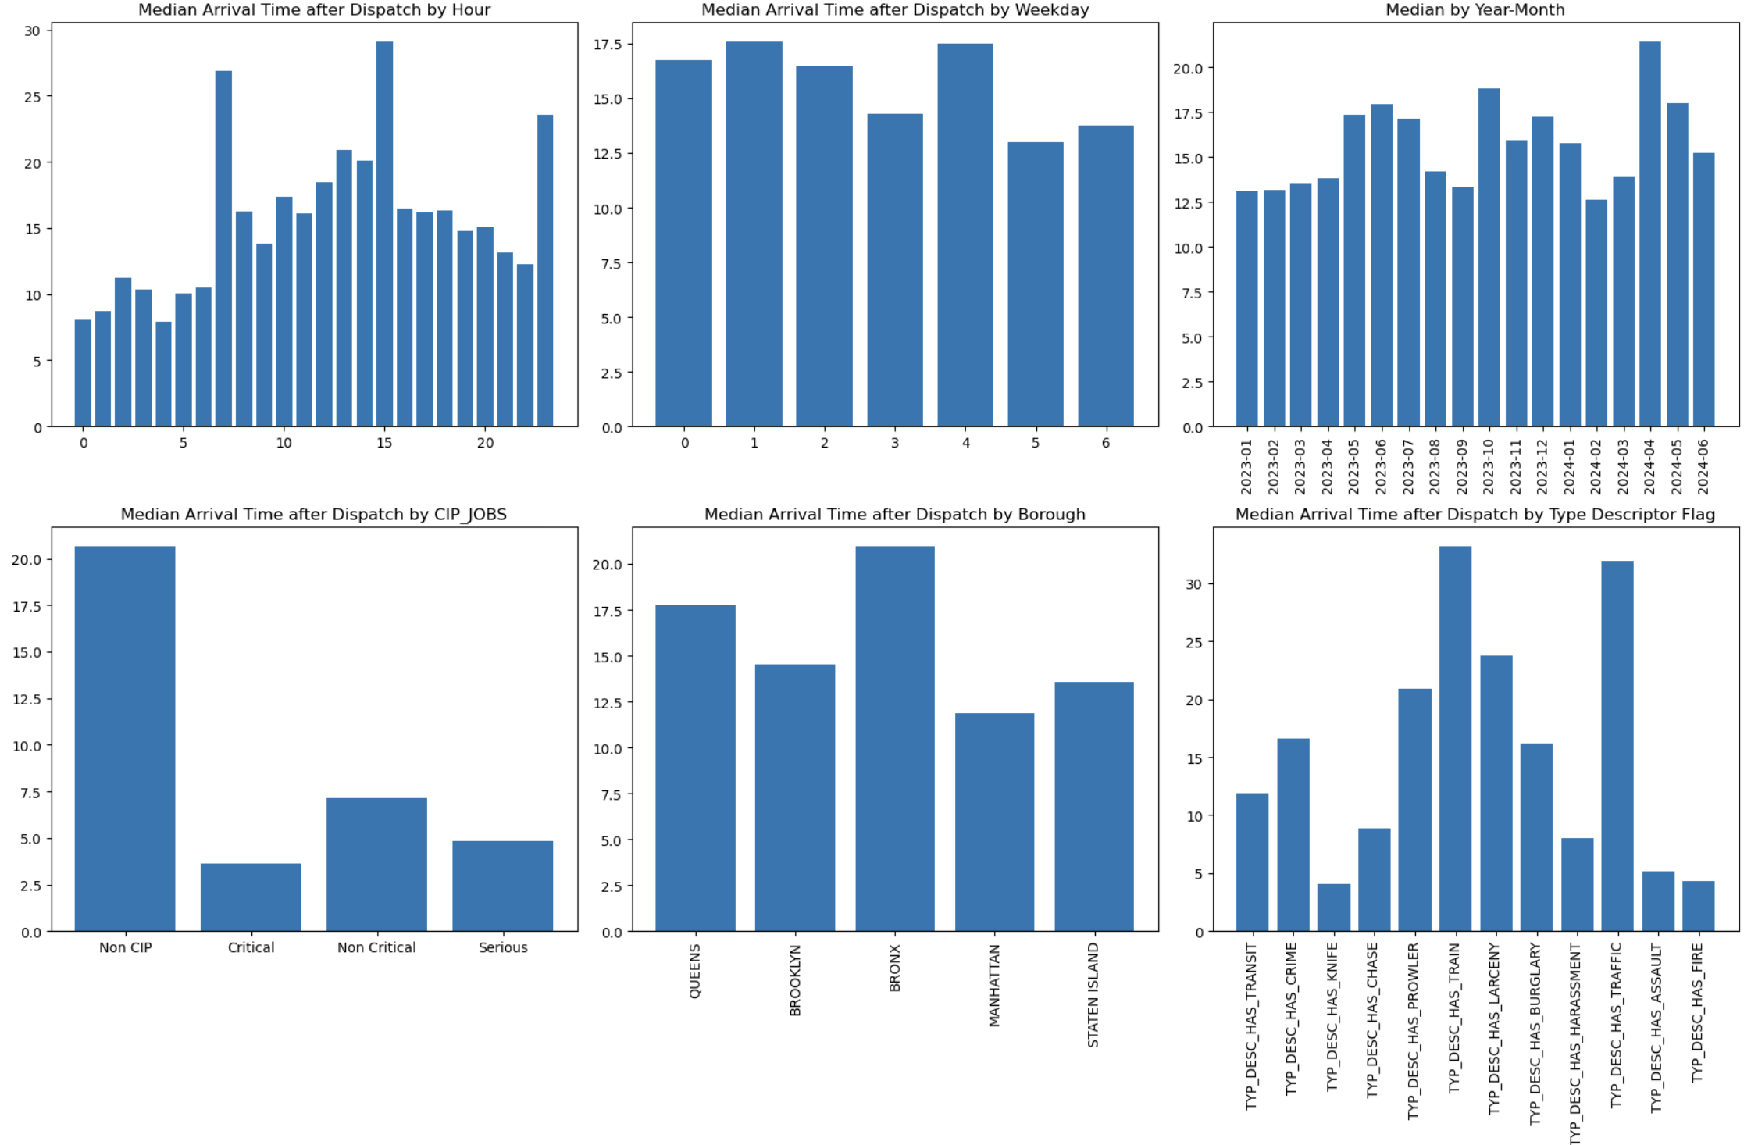
Evaluating and Understanding Data
Introduction
Data
Pipeline
Loading Data
Sampling Data
Cleaning Data
Evaluating Data
Model
Conclusion
Notes:
Three main aspects of this study. Input/Output, CPUs, and how these drive wait times. They all interconnect and input/output is an inevitable part of any CPU process, especially in today’s world as data grows larger and larger.
I’ll explore the operational considerations of custom CPU Scheduling algorithms in high I/O settings.
There is currently limited research on this specific aspect
I’ll also share where processes experience long I/O waits, such as those found in an airline kiosk setting.

Slide 12
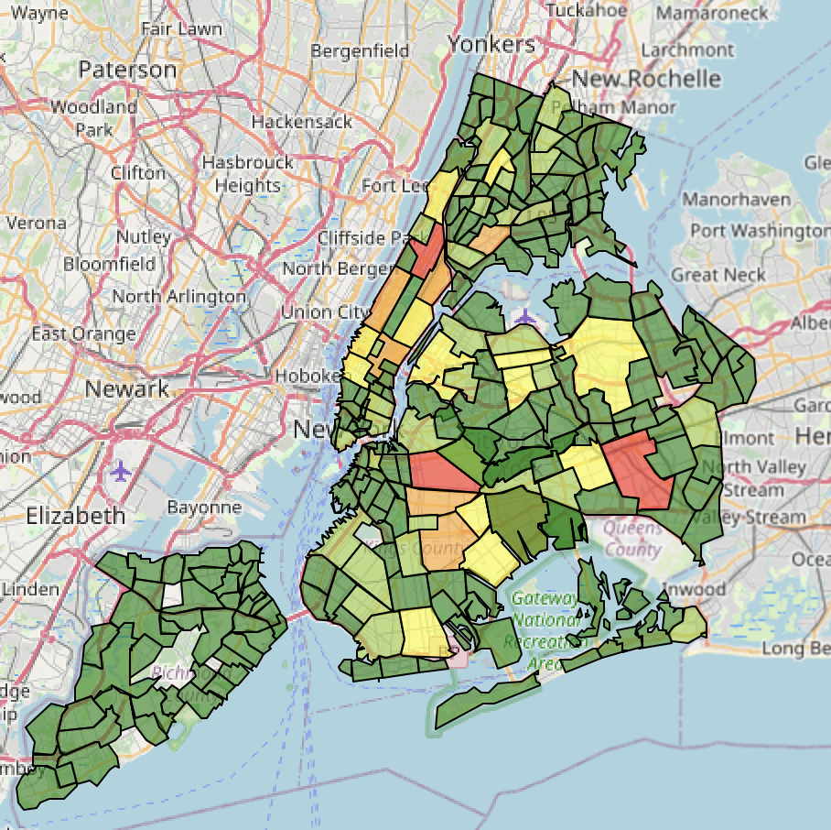
Evaluating and Understanding Data
Red: 100th Percentile
Orange: 80th Percentile
Yellow: 60th Percentile
Yellow-Green: 40th Percentile
Green: Bottom 20th Percentile
Introduction
Data
Pipeline
Loading Data
Sampling Data
Cleaning Data
Evaluating Data
Model
Conclusion

Slide 13
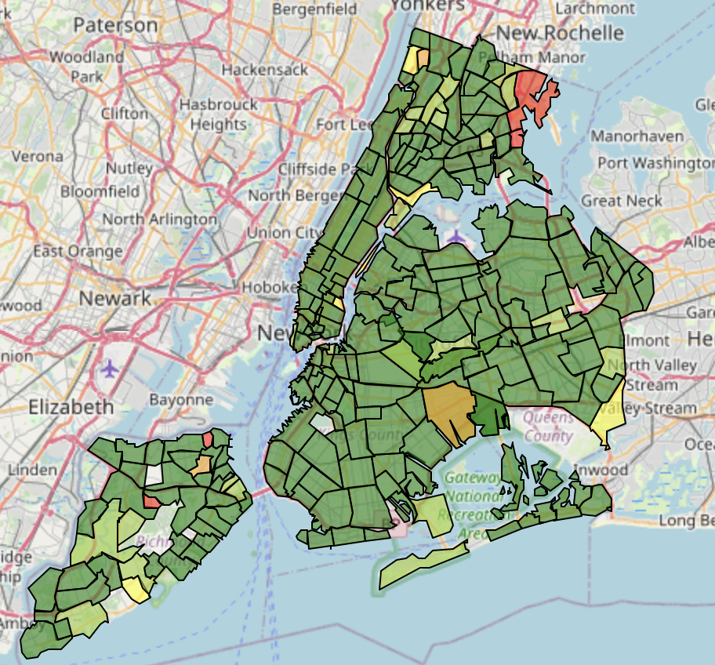
Evaluating and Understanding Data
Red: 100th Percentile
Orange: 80th Percentile
Yellow: 60th Percentile
Yellow-Green: 40th Percentile
Green: Bottom 20th Percentile
Introduction
Data
Pipeline
Loading Data
Sampling Data
Cleaning Data
Evaluating Data
Model
Conclusion

Slide 14
Machine Learning Models
Filter out actual arrival times greater than 40 minutes and less than 3 minutes
Create a test and training data set
Training data set: 80%
Test Data Set: 20%
columns = [
"BORO_NM",
"RADIO_CODE",
"CIP_JOBS",
"NEIGHBORHOOD"
]
Create index values off of String columns
Introduction
Data
Pipeline
Loading Data
Sampling Data
Cleaning Data
Evaluating Data
Model
Conclusion

Slide 15
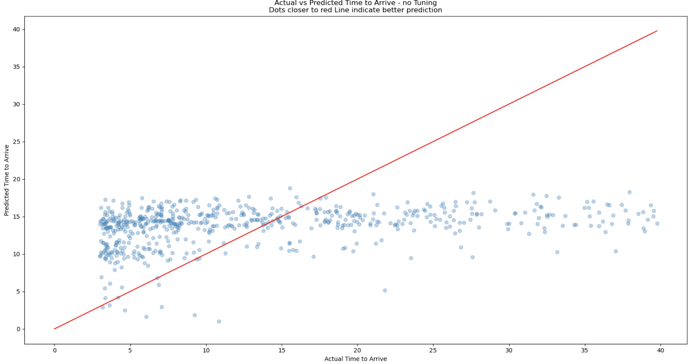
Machine Learning Models
RMSE: 9.27
Introduction
Data
Pipeline
Loading Data
Sampling Data
Cleaning Data
Evaluating Data
Model
Conclusion
Notes:
Three main aspects of this study. Input/Output, CPUs, and how these drive wait times. They all interconnect and input/output is an inevitable part of any CPU process, especially in today’s world as data grows larger and larger.
I’ll explore the operational considerations of custom CPU Scheduling algorithms in high I/O settings.
There is currently limited research on this specific aspect
I’ll also share where processes experience long I/O waits, such as those found in an airline kiosk setting.

Slide 16
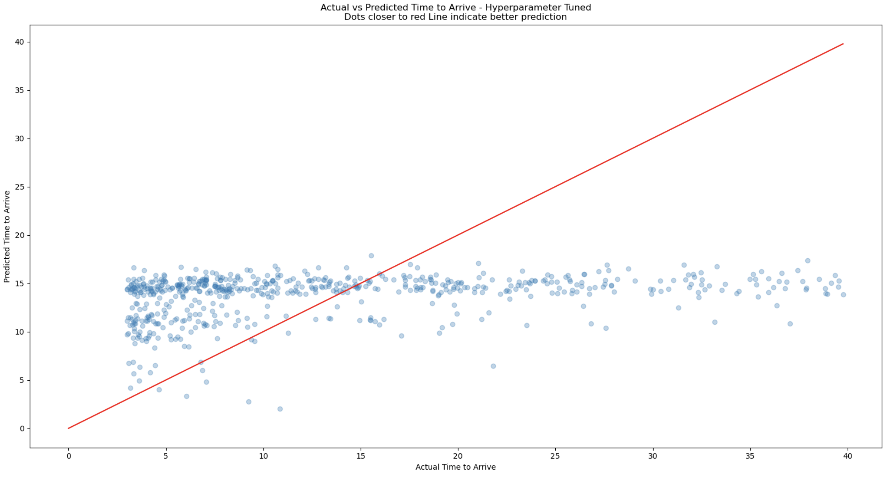
Machine Learning Models
Rerun model with tuning
Parameter Grid
Cross Validator with 5 folds
Hyperparameter Takeaways
Hyperparameter tuning can lead to overfitting on the training data
Chosen parameter grid might not be optimal
Can sometimes make the model too restrictive or too flexible
RMSE: 9.31
Introduction
Data
Pipeline
Loading Data
Sampling Data
Cleaning Data
Evaluating Data
Model
Conclusion
Notes:
Cross Validation: performs cross-validation by splitting the dataset into several folds and training the model on each fold with different combinations of hyperparameters.
ParamBrid Builder: "Systematically explore a range of hyperparameter values to find the best combination that maximizes model performance”

Slide 17
Conclusion
Takeaways
Next Steps
Can be incredibly difficult to clean and parse data from public sources
Models often need lots of work to get them in shape
Can be incredibly difficult to predict things that have many more inputs than what can be represented in data
Further tune the model by removing ancillary features
Run the model Borough by borough, or even neighborhood by neighborhood
Run the model through Dask or other ML Models
Bring in more historic data
Bring in weather data to see if weather on a given day affects the arrival time
Introduction
Data
Pipeline
Loading Data
Sampling Data
Cleaning Data
Evaluating Data
Model
Conclusion
Notes:
Three main aspects of this study. Input/Output, CPUs, and how these drive wait times. They all interconnect and input/output is an inevitable part of any CPU process, especially in today’s world as data grows larger and larger.
I’ll explore the operational considerations of custom CPU Scheduling algorithms in high I/O settings.
There is currently limited research on this specific aspect
I’ll also share where processes experience long I/O waits, such as those found in an airline kiosk setting.

